Slide 1
From Whole Genome Sequencing toward precision medicine: A preliminary case study with EGFR
Wanlin Zheng
Josh Bloomstein
Eric Danziger
Stephanie Kinnunen
Team: HIF1a is not an oncogene
SVAI P1RCC May 20, 2018
Notes:
Mr. Baseman and SVAI

Slide 2
Identification of mutations using our patient dataset SNP-FF
Notes:
Invasion (matrix metalloproteinases), Proliferation (STAT2), DNA repair (ATM), development (Notch), hypoxia (HIF1A)

Slide 3

Multiple mutations in EGFR signaling pathway
Targeting protein upstream of constitutively activating mutation is not effective
Redundant signaling may allow cancer cells to escape targeted therapies
ERK and Akt inhibitors in trials
Functional Proteomics to dissect tyrosine kinase signalling pathways in cancer, Kolch et al., Nature Reviews Cancer, 2010.
Notes:
Single drug, synthetic lethality

Slide 4
Oncotype DX 21 gene breast cancer panel assays for narrow range of mutations
HER2 RT-PCR
Small gene panels may not include mutation information on driver genes

Slide 5
Analyzing TCGA KIRP RNA-Seq to evaluate signatures related to clinical outcome
Gene
Log2 + 1, gene z scores
Patient
Notes:
500 DEGs at 1.5 fold-change, 0.1 FDR

Slide 6
Principal Component Analysis of TCGA KIRP RNA-Seq (all genes)
Vital status
Tumor stage

Slide 7
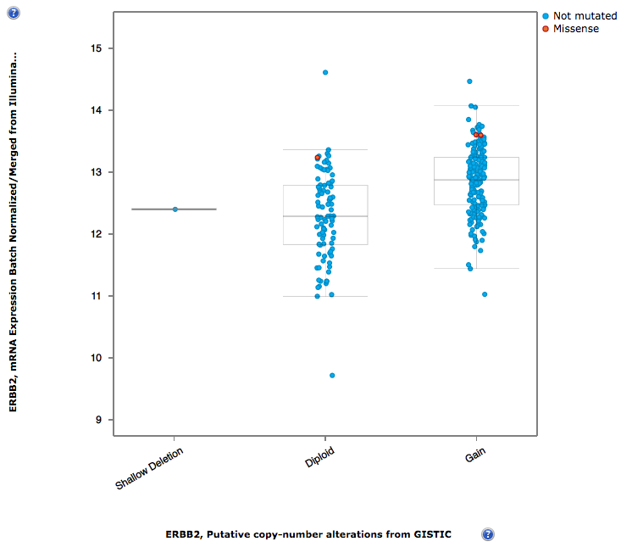
TCGA KIRP Copy Number Variation gain may be associated with higher mRNA expression of HER2 (ERBB2)
HER2+ breast cancer treated relatively effectively Herceptin
Extended to HER2+ gastric cancer
cBioPortal
Notes:
Repositioned

Slide 8
Cox Proportional Hazard Model
Surv(Death, Followup days) ~ Gene
Using TCGA gene expression values based our patient mutation list
Notes:
FGFR1 growth factor, CDK4 cell cycle, MSH2 mismatch repair (immunotherapy), MAPK8 (ERK) signal transduction, E2F2 cell cycle, MS, 0.05 ~1000 total, 0.01 232

Slide 9
Conclusions
Whole genome sequencing can potentially reveal actionable mutational signatures not identified by targeted (small panel) sequencing
Eg. EGFR pathway, potential Cetuximab resistance
Individual’s mutation burden can differ vastly from TCGA population, complicating clinical trials/standard of care model of treatment for cancer
Integration of genome sequencing and RNA-seq may offer potential for identification and validation of therapeutic targets

Slide 11
Future directions
Creating a pathway differential expression score to apply to patients
Selected 5 gene sets from Broad Hallmarks database, within categories that patient has mutation
Pathways:
1. IL-6-JAK-STAT3-signaling
2. KRAS signaling up
3. p53 pathway
4. Hypoxia signaling
5. PI3K Akt mTOR signaling

Slide 12
Principal Component Analysis of TCGA KIRP patients by pathway activation score
Low IL-6
Colors represent gross activation of cancer-related pathways
Each group is a combination of high/low of 5 pathway sets
Use feature selection and machine learning to models for predicting clinical outcomes in KIRP

